Slide 1
Work- Place Skills Lecture-5
Department Of Humanities and Social Sciences, Jaypee Institute of Information Technology,Noida

Slide 2
Topics to be covered:
Interpersonal Skills
Definition
Team
Emotional Intelligence
MCQ
References:Stephen P. Robbins, Timothy A. Judge, Marissa Edwards, Peter Sandiford, Martin Fitzgerald, James Hunt, Pearson Australia, 2019

Slide 3
Interpersonal Skills
The ability to work effectively with a group of other people, either as leader or as member, is an important interpersonal skill” (Hayes, 1991, p. 208)
Notes:
Source:PRESENTATION NOTES FOR INTERPERSONAL SKILLS MODULE,Generic Skills Integration Project (GENSIP), University of Dublin, Trinity College

Slide 4
Aim of Interpersonal skills
To explore the benefits of learning in groups
To learn about how groups work
To consider effective group characteristics
To experience some basic skills of group work
To learn how to communicate results of group work
Notes:
Source:PRESENTATION NOTES FOR INTERPERSONAL SKILLS MODULE,Generic Skills Integration Project (GENSIP), University of Dublin, Trinity College

Slide 5
Benefits of interpersonal skill
Personal relationship
Professional relationship
Employment related skill
Team or group-work
Share workload
Learn about other perspectives

Slide 6
TEAM
Definition :“A team is a small group of people with complimentary skills, who work actively together to achieve a common purpose for which they hold themselves collectively accountable.”

Slide 7
Teams in Organizations
Teamwork is the process of people working together in teams to accomplish common goals
Notes:
7

Slide 8
Pre-requisites for Team Building and Team Work
Common objectives
Trust
Cooperation
Support
Information sharing
Mutual respect
Accountability
Positive group- no back-biting or stabbing at the back

Slide 9
Team Skills
Flexibility and adaptability
Commitment to team’s goal
Energy
Focus
Persistence

Slide 10
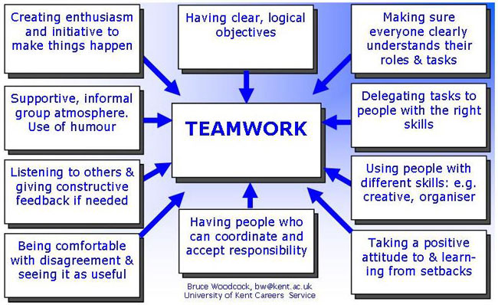
Notes:
Bruce Woodcock,bw@kent.ac.uk, University of Kent Careers service

Slide 11
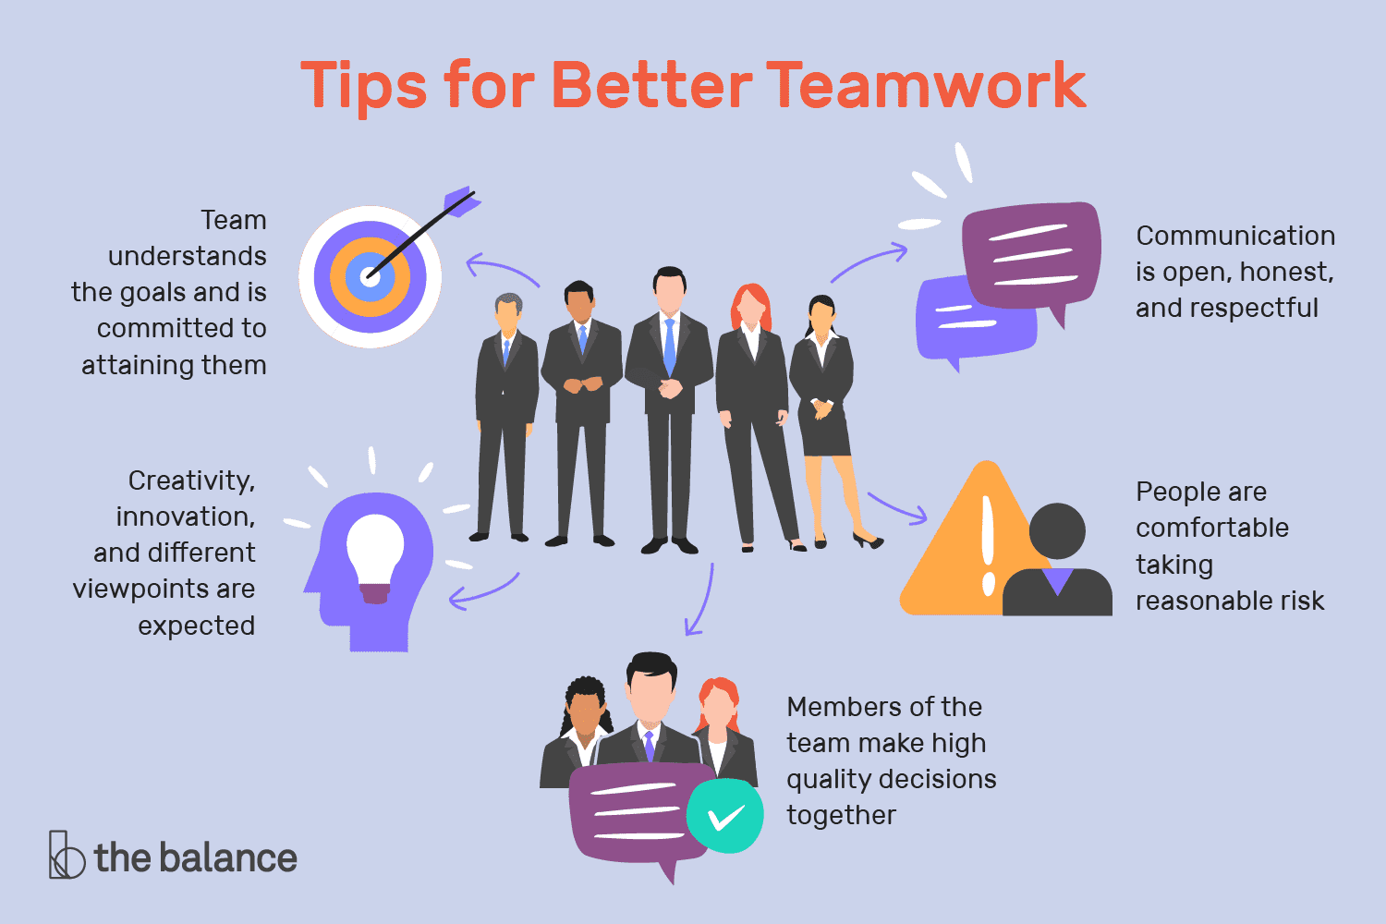
Notes:
Blog Post 4: Group Skills ,November 25, 2019,Theme images by Michael Elkan

Slide 12
EMOTIONAL INTELLIGENCE
“We are being judged by a new yardstick:
not just how smart we are, or by our
training and expertise, but also by how well we
handle ourselves and each other”
-- Daniel Goleman,
Working With Emotional Intelligence, 1998

Slide 13
Emotional Intelligence
“ Emotional Intelligence” refers to the capacity for recognizing our own feelings and those of others, for motivating ourselves, and managing emotions well in ourselves and our relationships.
“EI refers to someone’s ability to perceive, understand and manage their own feelings and emotions” (Chignell, 2018).

Slide 14
THE PROBLEM WITH A MEMBER WITH LOW EI IS…
Can’t view things objectively.
Takes things, personally.
Has poor interpersonal skills.
Can be arrogant.
Often hurts others.
Takes rash decisions.
Is self-centered and self-seeking.
Is low on motivation.
Has huge inertia.
Does not know his potential.
Does not have space for others.
Loses will to survive.
Indulges in self-pity.
Show too many emotions.
Gets affected by anything that happens around him
His performance depends on the surroundings

Slide 15
WHEN THE MEMBERS HAVE LOW EI, IT LEADS TO …………. IN THE GROUP
Wastage of time and energy
Lack of focus on organizational climate
Underachievement
Inter-personal problems
Inability to be a team player
Unsustainable performance
Insecurity in the organization due to unpredictability
Mood swings in the team
Need for counseling
Unhealthy competition amongst employees
Doubts on the validity and reliability of the selection procedure

Slide 16
Five distinct components of EI:
Self-Awareness
Self-Regulation
Motivation
Empathy
Social Skills
Personal Competence: these competencies determine how we manage ourselves ie Self awareness, Self regulation and Motivation
Social Competence: these competencies determine how we handle relationships ie Empathy and Social skills

Slide 17
(1) Self – Awareness:
Knowing one’s internal states, preferences, resources & intuitions
Emotional Awareness
Accurate Self-assessment
Self-Confidence

Slide 18
(2) Self – Regulation
Managing one’s internal states, impulses and resources
.
Self- Control
Trustworthiness and Conscientiousness
Innovation and Adaptability

Slide 19
(3) Motivation
Emotional tendencies that guide or facilitate reaching goals
Achievement drive
Commitment
Initiative and Optimism
“If your actions inspire others to dream more, learn more, do more and become more, you are a leader.”
John Quincy Adams (1767-1848) sixth President of the United States

Slide 20
(4) Empathy
Awareness of others’ feelings, needs and concerns
Understanding Others
Developing Others
Service Orientation
Leveraging diversity
Political Awareness
Anyone can become angry—that is easy. But to be angry with the right person, to the right degree, at the right time, for the right purpose, and in the right way—this is not easy.
--ARISTOTLE

Slide 21
(5) Social Skills
Adeptness at inducing desirable responses in others
Influence
Communication
Conflict management
Leadership
Change Catalyst
Art of Collaboration

Slide 22
MCQ
1. A group of people working with common objectives or goals is known as a _________ a) Team b) Teamwork c) Group d) Club
2. The cumulative action of a team in which an individual member keeps aside his/her interests and opinions to fulfill the objectives or goal of the group is known as _________ a) Team b) Teamwork c) Group d) Club

Slide 23
3.The higher the Trait EI …
a)the higher the likelihood of personality disorder
b)the lower the likelihood of personality disorder
c)the higher the likelihood of self-harm
d) the higher the likelihood of harm to others
4. Emotional intelligence is different from other intelligences in that …
a)it is a set of skills
b)can be measured using tests easily
c)the focus is on emotional reasoning, ability and knowledge
d)it is a new type of intelligence
5.Empathic listening is operationally defined as
a)probing, supporting, and understanding
b)probing, advising, and understanding
c) probing, advising, and interpreting
d) probing, evaluating, and advising.

